Slide 1
Transforming procurement functions for an AI-driven world
Week 13 Ed Elowson Procurement and Supply Chain

Slide 2
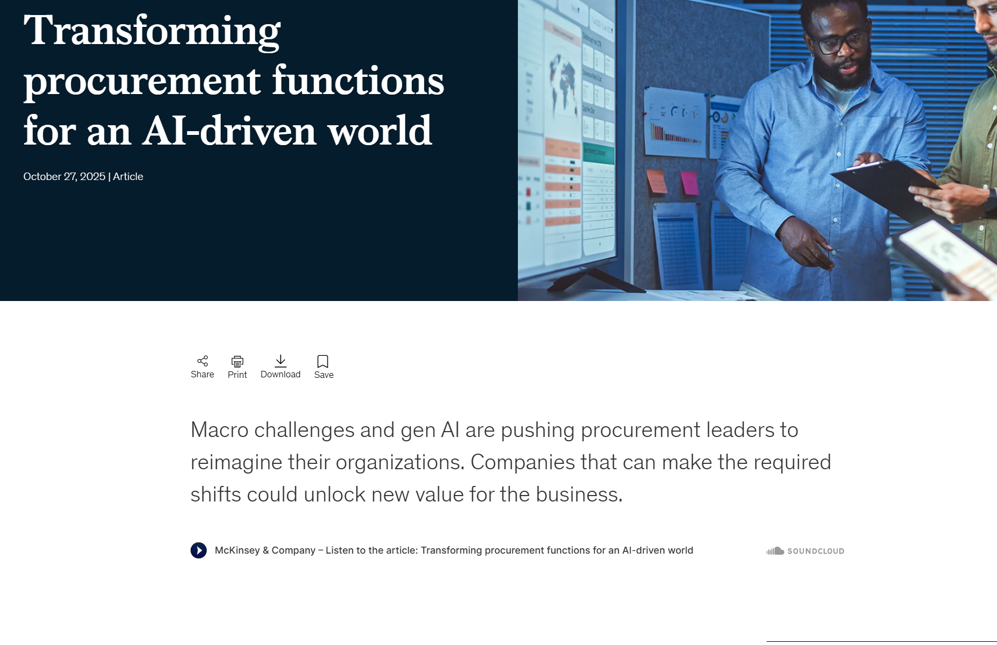
Screenshot

Slide 3
Link To The Source
https://www.mckinsey.com/capabilities/operations/our-insights/transforming-procurement-functions-for-an-ai-driven-world

Slide 4
Main Findings
The article argues that procurement is being fundamentally reshaped by two converging forces: economic volatility and rapid advances in generative and agentic AI. Procurement teams are managing significantly more spend with leaner teams than they did five years ago, which is pushing organizations to automate transactional work and shift human talent toward strategic functions like supplier relationships, category strategy, and risk management. The strongest-performing organizations are separating strategic and transactional procurement, building centers of excellence (COEs), and investing in digital tools like procure-to-pay systems, e-sourcing platforms, and AI-powered analytics. McKinsey’s core finding is that AI agents could improve procurement efficiency by 25–40%, while also uncovering substantial savings through spend visibility, contract compliance, and supplier optimization.

Slide 5
Broader Implications for Society
At a societal level, this shift reflects a broader transformation of knowledge work, where AI is increasingly becoming a collaborative “digital coworker” rather than just a software tool. That could improve productivity, reduce waste, and lower costs across industries, ultimately affecting the prices consumers pay and the resilience of supply chains. However, it also changes workforce dynamics: repetitive administrative roles may shrink while demand grows for strategic, analytical, and relationship-driven skills. This could widen skill gaps in the labor market and increase pressure on education and workforce development systems to retrain professionals for AI-augmented roles. It also raises governance questions around transparency, supplier fairness, and overreliance on algorithmic decision-making.

Slide 6
Relevance To The Construction Industry
For construction, the implications are especially significant because procurement directly affects project timelines, labor coordination, and material cost volatility. Construction procurement has traditionally been fragmented, reactive, and highly manual, with large exposure to supplier delays, price swings, and change orders. AI-enabled procurement could help contractors and developers forecast material needs, compare supplier pricing in real time, flag contract leakage, and reduce procurement delays on critical-path items like steel, concrete, electrical gear, and HVAC systems. In an industry where margins are often tight and schedules drive profitability, moving procurement from an administrative function to a strategic cost-control and risk-management function could materially improve project delivery, reduce overruns, and strengthen supply-chain resilience—especially as construction faces labor shortages and infrastructure demand continues to rise.

Slide 7
